Slide 1
Recent progress with Headphones and Concert Hall Acoustics
David Griesinger
www.davidgriesinger.com

Slide 2
At the recent ISRA conference in Amsterdam Neil et. al. found “proximity” accounted for 85% of the variance of preference for concert hall sound.
“But,” he exclaimed, “there is no measure for Proximity!”
  “Proximity”, the sense of being sonically close to the performers, depends on the ability to sharply localize each instrument.
  We find when listening in halls to live music with eyes closed there is a distinct distance from the source where proximity fails.
  We call this is the limit of localization distance, or LLD. Seats behind the LLC can be lush, but they lack the excitement and engagement of closer seats.
Why do our many measures for acoustic quality account for only 15% of preference?
  There is a famous quote attributed to Einstein: “Everything should be made as simple as possible, but not simpler“
The science of hearing and the science of acoustics have fallen into this trap.

Slide 3
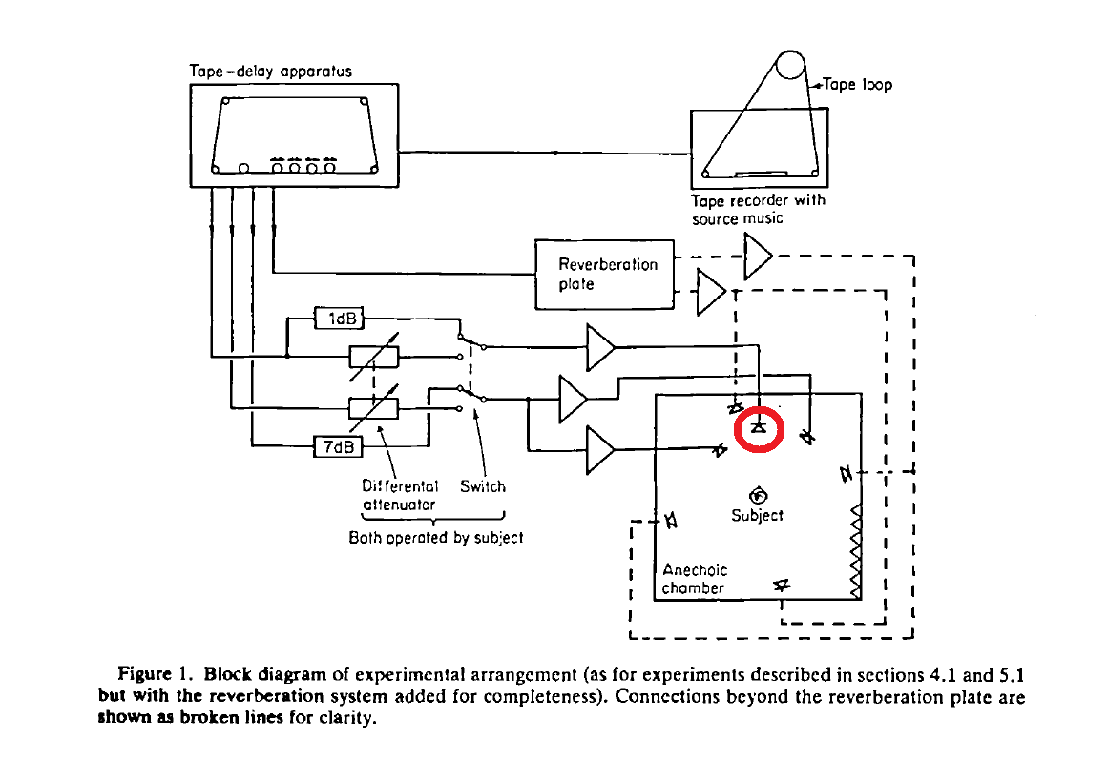
For Example: Barron and Marshall’s Classic Paper
Spatial Impression and the effect of early reflections
Journal of Sound and Vibration. (1981) 77(2), 211-232
Barron and Marshall’s classic paper on spatial impression used only a single speaker to reproduce a whole orchestra. The orchestra image was totally unrealistic. This is a very serious error.
They found that adding lateral reflections widened the image, making it somewhat more realistic.
They used the term “Apparent Source Width” (ASW) to describe what they thought was an improvement to the sound.
Acoustics textbooks have recommended strong early reflections ever since.
But strong early reflections eliminate Proximity.

Slide 4
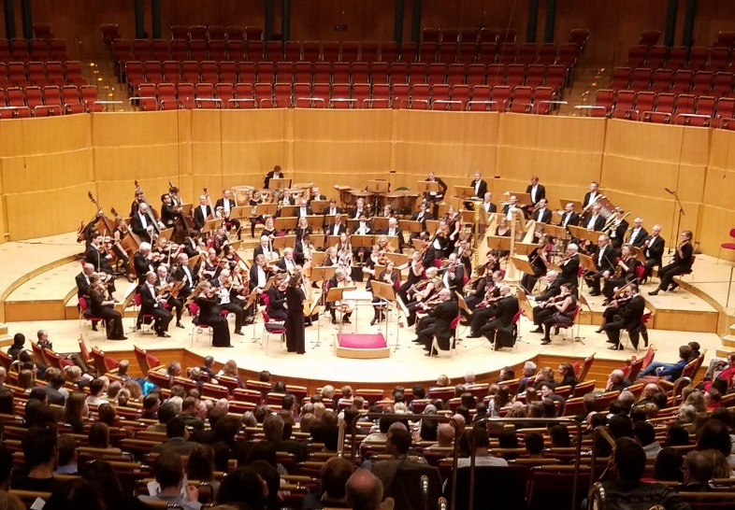
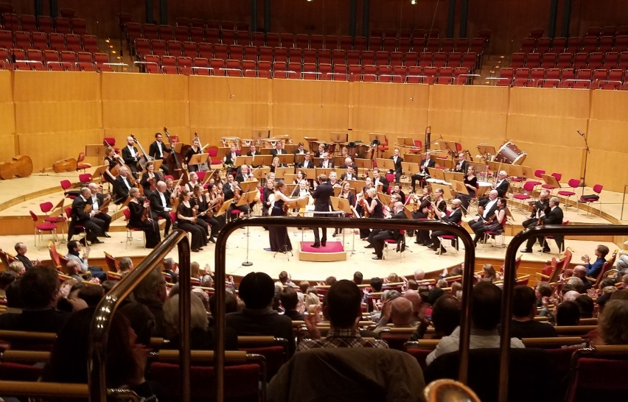
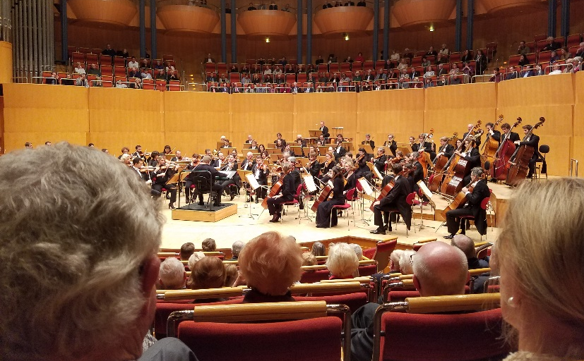

Our goal is to accurately record, hear and sonically compare the acoustic properties of seats in halls such as these in Cologne.
Row 28 seat 38 A bit muddy Row 22 seat 38 Clear but not loud Row 10 seat 6 Fantastic!
Our binaural recordings from these seats play with startling realism for most people. There is a powerful perception of “being there”.

Slide 5
A measure for Proximity
We designed a mathematical measure called LOC (for localization) that predicts from a binaural impulse response whether localization will possible or not. It works reasonably well.
  Matlab and C code for calculating LOC are on my website.
We believe that reproducing binaural recordings accurately to any individual is a powerful method for studying proximity and optimizing LOC.

Slide 6
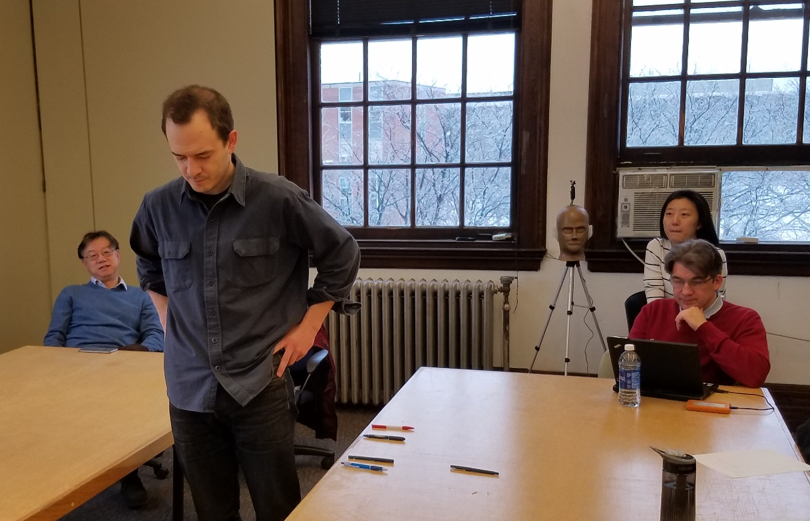
LOC predicts the LLD well from a small ensemble, but not necessarily in a small room with just 2 violins.
We did an experiment in a small classroom at Rensselaer University (RPI), using the violin 1 and 2 tracks from Lokki’s anechoic recordings.
Each listener dropped a pencil at the point where localization was lost. They agreed on where localization failed.
The LLD found by the listeners was several feet in front of the LLD predicted by LOC.
By experimenting with binaural recordings we found that violins are more difficult to localize than speech or woodwinds.
Using these experiments we made improvements to the code for calculating LOC.

Slide 7
There are two major over-simplifications in hearing research
First: Stream separation by pitch is essential for the perception of Proximity, and is only recently being studied.
The process by which allows us to separate sound streams from each other and from noise is extremely effective. When someone behind us quietly mentions our name our attention is immediately drawn to that person. In a good seat in a hall we can individually localize and follow particular instruments.
Second: Localizing sources in three dimensions by sound alone has also been neglected.
We perceive sounds from people, birds, and animals where we see them in three-dimensional space, and the timbre of each source as independent of its position in space.
We believe the only explanation for these abilities is that over our lifetime our brains build a data bank that uses the spectra from both ears to instantly identify the direction of sound sources in three dimensional space, and then remove the spectral changes that allowed the localization to be determined.
But the spectra at our eardrums are highly individual! Putting headphones on our ears alters the ear canal resonances, and our learned data bank no longer works.

Slide 8
This talk will be about optimizing headphones
Headphones work fine for most purposes.
  But I found that when you match them to an individual’s particular hearing resonances the result can be startlingly beautiful.
In 2007 I used probe microphones to record a concert in the Vienna Musikverreinsal from my eardrums. I played it back with headphones equalized at my eardrums with the same probes.
  The sound was stunning, better than any recording I had ever made.
But not in every seat. A little farther back the sound was mush.
Why did the sound suddenly lose Proximity? Binaural recording, when properly done, can help us find out.

Slide 9
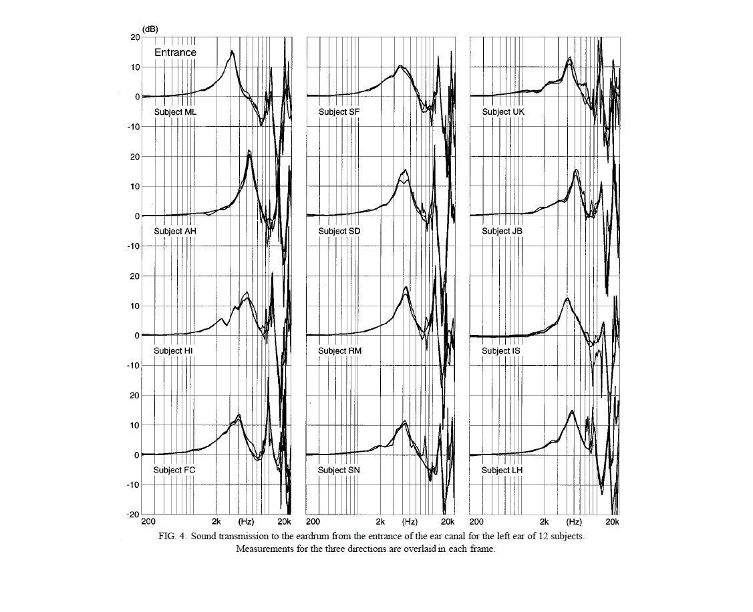
Binaural recordings allow us to test acoustic measures, but if we wish to hear them accurately we must account for ear canal resonances!
Almost all studies of binaural hearing measure both head related transfer functions (HRTFs) and headphone equalization at the entrance to the ear canal. But that is not the sound we hear.
Frontal localization and perceived timbre depends on the spectrum at the eardrum, not at the ear canal entrance!
Hammershøi measured the sound transmission from the entrance of the ear canal to the eardrum for three sound directions and 12 subjects.
The subjects differ from each other by more than +-10dB between 1000Hz an 6000Hz.
If we wish to play sound with headphones that is perceived as natural or realistic to an individual we need to duplicate their individual resonances using a reference outside the ear canal, Ideally from the front.

Slide 10
We have developed apps that use a simple listening test to match the spectra at the eardrum from pair of headphones to the spectra at the eardrums from a frontal loudspeaker.
  The result is frontal localization without head-tracking, and accurate localization in the frontal plane.
Playing binaural recordings after our
equalization is startlingly real.
In this talk we will show why the spectrum at the eardrum is so important to our ability to localize sound, and why individual headphone equalization at the eardrum makes such an improvement to the sound.
  We will also briefly describe a simple transaural system that can accomplish the same goal without individual equalization

Slide 11
The spectra at the eardrums are critical to sound localization
Our brains quickly compare the spectra at our eardrums to a stored data set that predicts almost instantly the direction of the source.
The brain continually updates our directional data set by comparing detected spectra to visual and other localization data.
Spectral differences due to source direction are almost always measured at the ear canal entrance, but this data is useless to an individual because the spectra at the eardrums is highly individual.
Differences between individuals can be more than +-10dB between 1000 and 7000Hz.

Slide 12
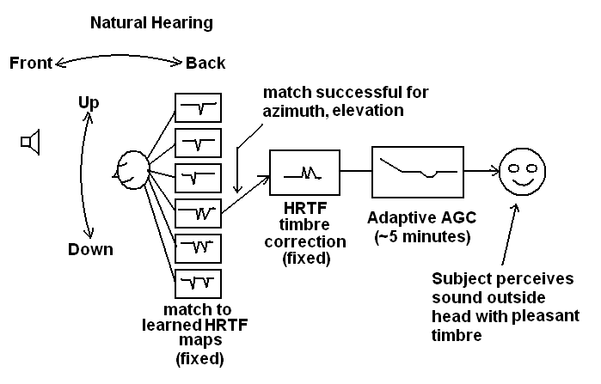
When a sound is heard ITD, ILD, and the spectral features are compared to stored data. The best match predicts the sound direction.
We do not hear these spectral differences – the brain removes them once a direction is found.

Slide 13
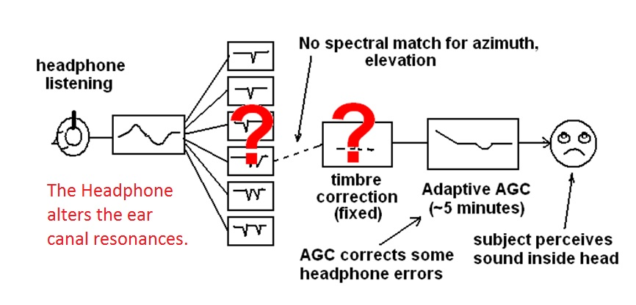
With headphones the spectra are very different. No directional match is found. We hear sound inside our head.
We adapt to the unnatural timbre of headphones within a minute or so through an adaptive equalizer which attempts to make all frequency bands equally audible. But localization stays broken.

Slide 14
If we move rapidly past a sound source we can hear the timbres that allow us to localize it.
I once heard a gliding whistle when I walked at about 3 mph under an overhead ventilator slot that emitted broadband noise.
  This is the uncorrected sound of the vertical HRTFs when they are not corrected.
  But the sound was correctly localized – even at higher speeds.
No timbre shift was perceived when walking slowly under the slot
  When there is sufficient time our brains correct the timbre. The correction takes time, in this case about half a second.

Slide 15
We can use headphones to play binaural recordings with accuracy if they reproduce our individual ear canal resonances!
Our method uses our equal loudness tests to measure these resonances.
Subjects listen to a series of 1/3rd octave noise bands that alternate between a test frequency and a reference frequency at 500Hz. They adjust the loudness of the test band to match the loudness of the reference band.
They do this first for a frontal loudspeaker, and then for a headphone. The difference between the two measurements creates the equalization that matches their headphone to their particular ears.
The result is frontal localization without head tracking, and natural timbre.
Binaural recordings equalized to be frequency linear from the front play with extraordinary realism.

Slide 16
Researchers keep searching for universal headphone equalizations
Hammershøi and Møller investigated whether the ear canal influenced the directional dependence of the human pinna system.
  They concluded that measuring the sound at the blocked entrance to the ear canal captured all the directional dependence of the HRTF functions.
So they recommended that headphones be equalized at the ear canal entrance!
But the frequency spectrum that we measure at a blocked or open ear canal entrance is not the frequency spectrum at the eardrum.
The only timbre the brain can use to localize is the timbre at the eardrum, and this is highly individual!

Slide 17
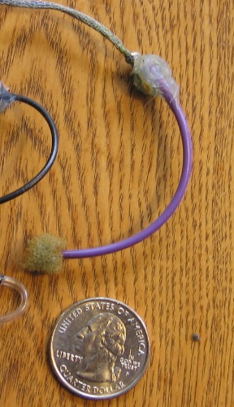
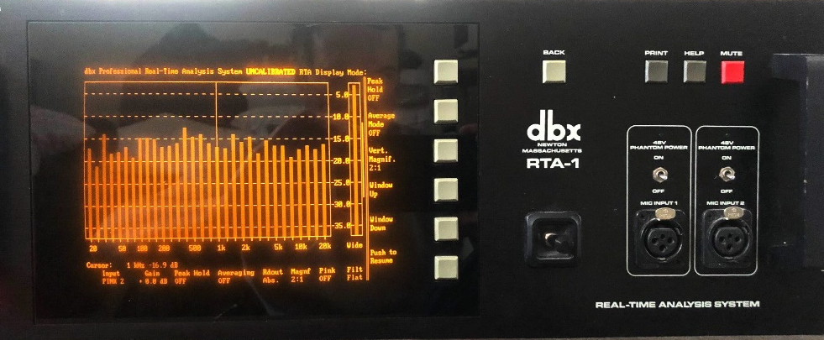
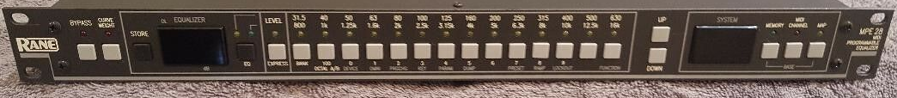
I made a probe from a length of wire insulation and an electret microphone. It was not comfortable, but it measured my eardrum spectrum accurately. Fortunately the DBX RTA1 became available.
About 1980 I decided to measure the sound spectrum at the eardrum from a frontal loudspeaker, and then compare it to the spectrum from a headphone.
The DBX could plot response curves, store them, and subtract the two measurements from each other. I loaded the results into an equalizer.
The result was spectacular. Frontal localization and natural timbre.
A Rane 32 band 1/3 octave EQ
I used this setup while recording on-location music for thirty years.
But I did not realize that a headphone equalization that works for me does not work for other people.

Slide 18
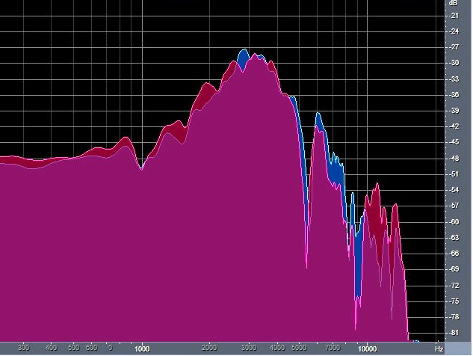
The spectrum at the ear canal entrance depends on the pinna and the concha, which alter the spectrum as a function of direction. But the spectrum is further modified by the ear canal resonances.
To reproduce natural hearing we need to measure the sound pressure from outside the head to the eardrum, and reproduce this spectrum when we play music.
The most important direction to measure is from the front, because this is where we need to hear most accurately!
My ear canal resonances increase the pressure at the eardrum by 18dB at 3000Hz. This greatly increases the sensitivity of my hearing.
Your eardrum spectrum will be different, but equally useful.
This graph shows the pressure at my eardrums from a source 40 centimeters in front of my head. Left ear is blue, the right ear is red.

Slide 19
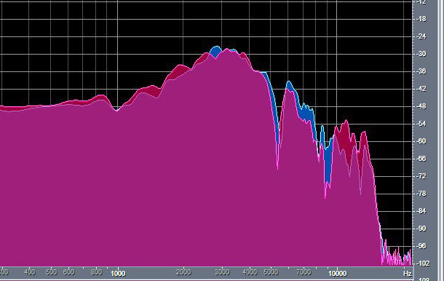
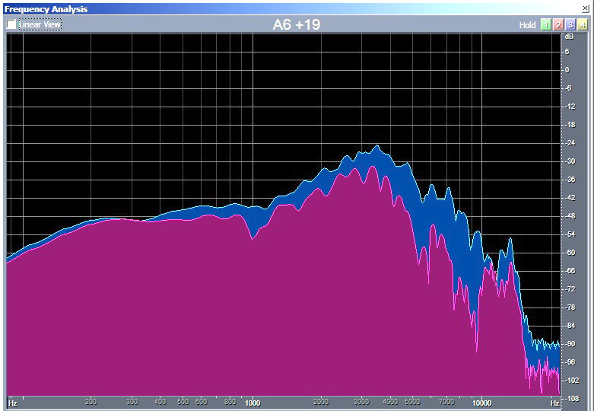
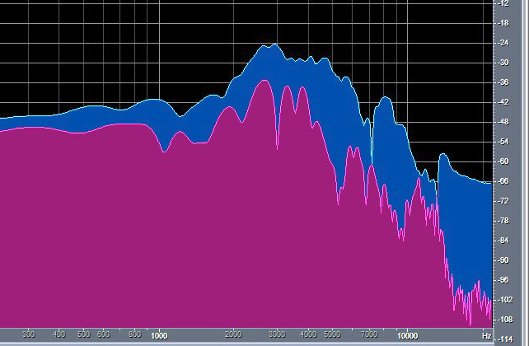
The timbres my brain uses to detect azimuth and elevation are highly audible
Eardrum spectrum from the front Eardrum spectrum 30 degrees left Eardrum spectrum 60 degrees left
Blue is from the left ear, Red is from the right ear.
My brain recognizes these individual timbres to localize the sound and perceive it as frontal and outside the head.

Slide 20
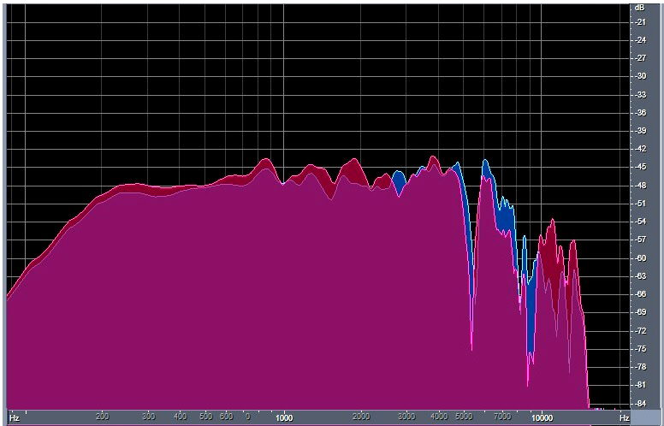
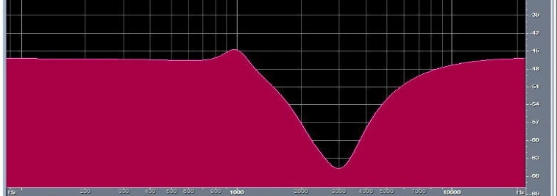
We can study the directional dependence of sources more easily if we use a parametric filter to make the frequency spectrum from the front as linear as possible.
+
=
A four section parametric equalizer
F Q dB
2.5 -10
2.5 -13
3 3
990 3 4
Pressure at my eardrums from a frontal source.
My eardrum pressure from a frontal source after equalization.
We will use this equalization to make the following graphs.

Slide 21
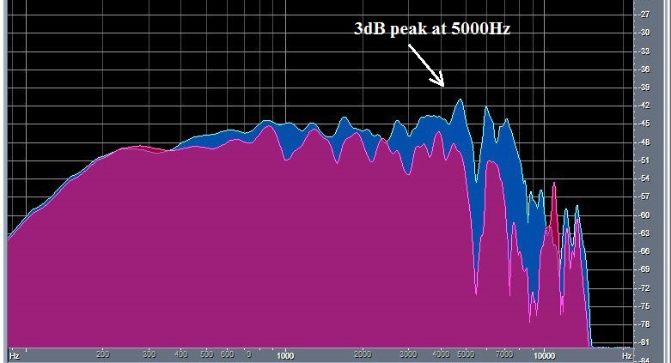
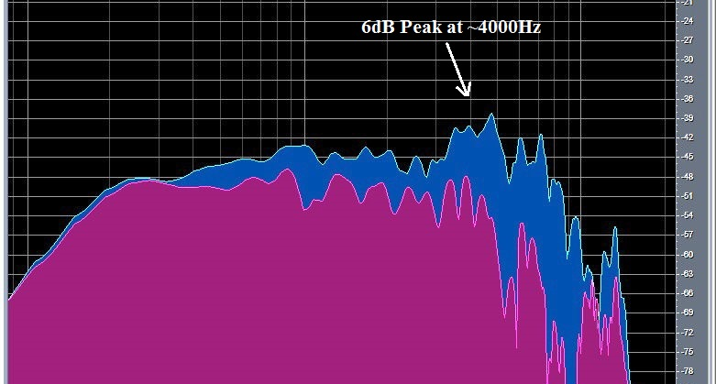
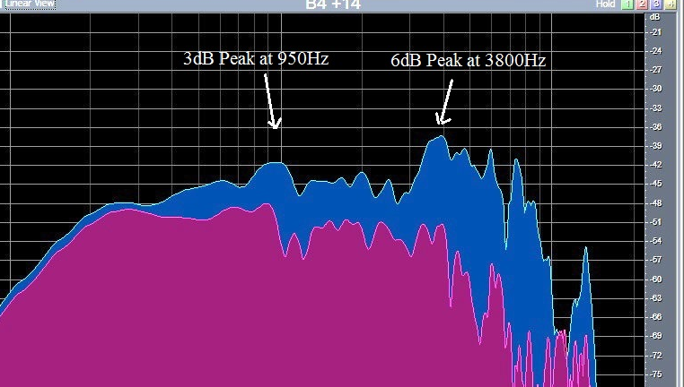
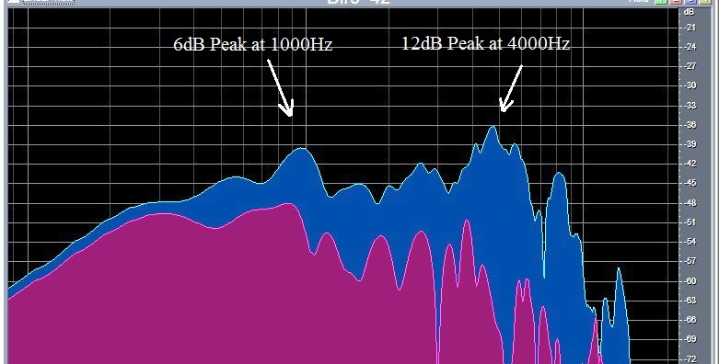
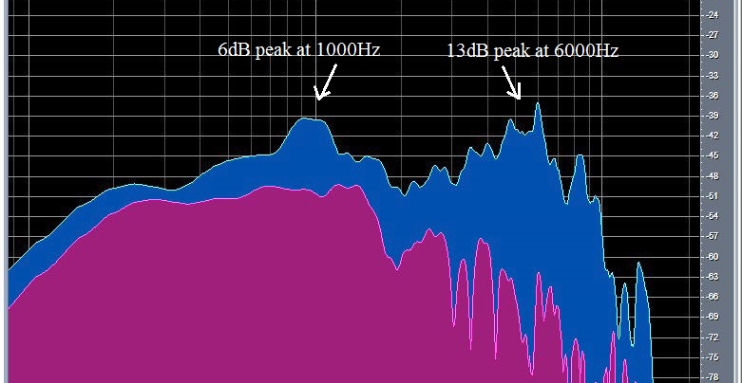
The author’s frontally equalized eardrum pressure as a function of angle in the horizontal plane. The peaks you see here are highly audible, and are important components of localization!
Front spectrum is flat
15 degrees right has a 3dB peak
30 degrees right has a 6dB peak
45 degrees, 3dB at 950, 6dB at 3800
60 degrees, 6dB at 1000, 12dB at 4000
90 degrees 6dB at 1000, 13dB at 6000
When I play these noises with crosstalk cancellation or equalized headphones the localization is precise, and the timbre is perceived as constant.

Slide 22
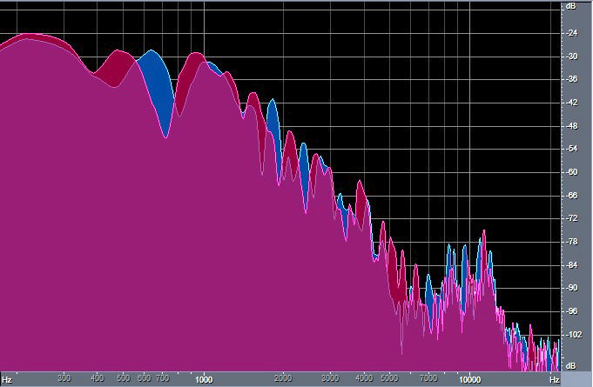
The ear canal is like a clarinet, with one open end and one closed end. It resonates strongly at 3000Hz, but suppresses even harmonics.
This is why there is a deep notch at ~5500Hz in my ear canal.
The notch may look insignificant in the spectrum at left – but it has a large effect on binaural music.
The spectrum of my HRTFs after equalizing from the front.
The spectrum from a bit of the Beethoven violin concerto recorded from my eardrums after equalizing from the front. Note the dip at 5kHz to 8kHz.

Slide 23
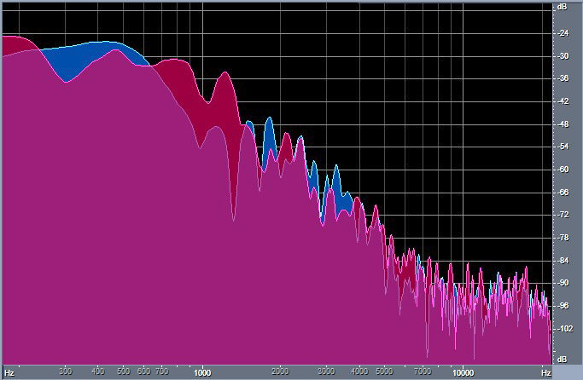
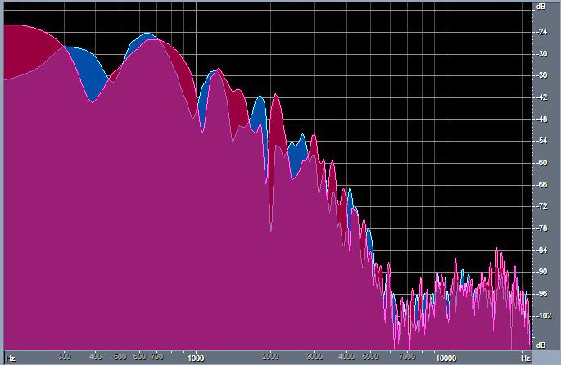
My individual notches are important for the localization and externalization of the sound image.
Here is a spectrum from the Beethoven violin concerto recorded from my eardrums in Hamburg.
Here is the same passage recorded by a friend with microphones in his concha.
I used a parametric equalizer to add a -14dB dip at 6500Hz to the concha recording. It sounds more real to me.
With equalized headphones my eardrum recording was realistic. My friend’s recording localized inside my head and was too bright. Adding a -14dB dip at 6700Hz with a Q of 3 brought the recording forward and outside my head. It sounded similar to the one from my eardrums.

Slide 24
Head Tracking
Virtual realty systems rely on head tracking to achieve frontal localization.
Head motion produces azimuth cues that are so compelling that the brain learns to ignore the timbre cues from the head and pinna.
But perceptions that depend on timbre, such as elevation, intelligibility and sound balance, are unnatural and can be misleading.

Slide 25
People have heads and pinna of different sizes and shapes. Can a binaural recordings made for one person work for others?
We believe this is possible if the recordings are equalized to be flat from the front.
Timbre changes gradually in the front +- 30 degrees of azimuth, and ILD and ITD vary predictably.
Binaural recordings equalized to be frequency flat from the front have similar localization cues for all people, although with possible differences in scale.
We make frontally equalized binaural recordings from our own eardrums and from dummy heads. When we play them to others with individual equalization they report a strong perception of “being there”

Slide 26
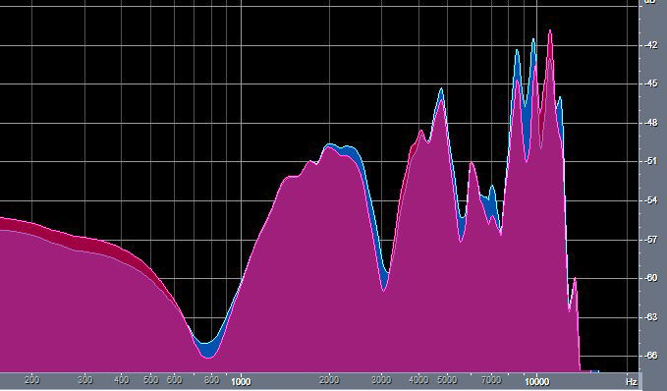

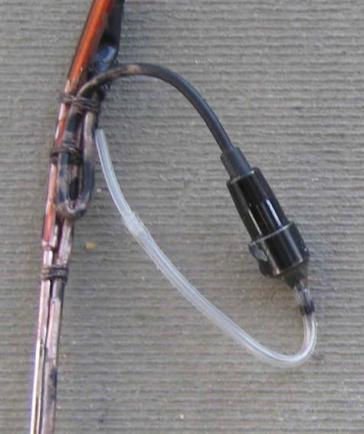
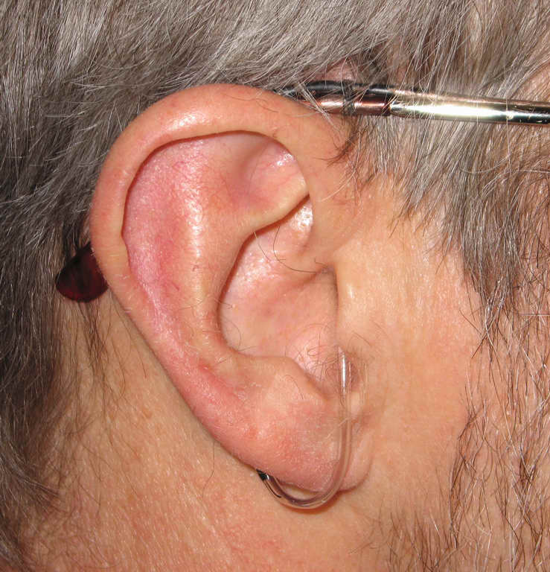
Making binaural recordings from my eardrums.
I make binaural recordings from my own eardrums using soft tipped probes attached to my eyeglasses.
There is a YouTube video showing how to make the probes.
Probe microphone inverse function frontal eardrum inverse function
The recordings are first equalized with a Matlab-calculated inverse of the probe response. The recording is then equalized to be flat from the front using the four section parametric filter shown earlier. The recordings play beautifully on loudspeakers, and are spectacular when played on equalized headphones.
The probes are comfortable, discrete, and do not obstruct my hearing.

Slide 27
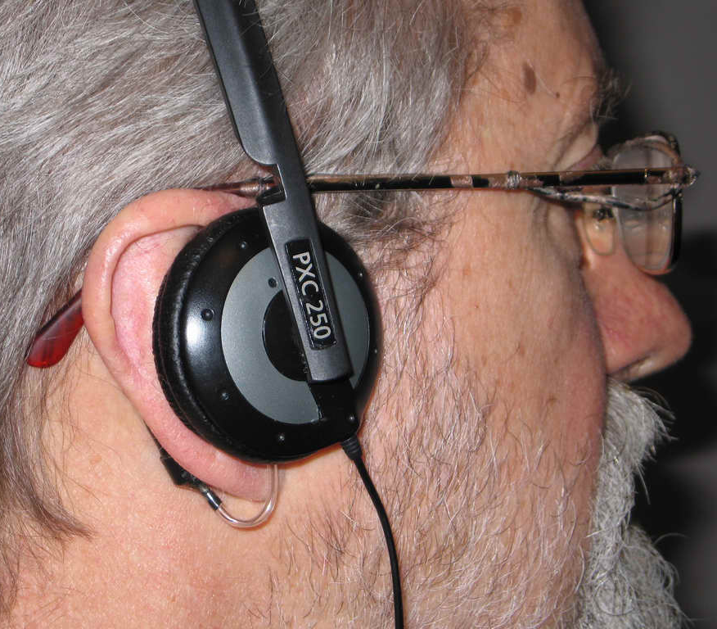
Equalization of headphones with probe microphones
We carefully place headphones on the listener while the equalized probe microphones are in place.
We measure the sound spectrum at the eardrums, and construct an inverse filter for these phones.
When this is done carefully, the sound spectrum at the eardrum during the recording will be exactly reproduced.
For precise vertical localization a mathematical inversion may be necessary. But I prefer to construct inverse filters using a small number of minimum phase parametric equalizers, or our 1/3 octave Q=5 graphic equalizer.
I no longer use probes to equalize headphones. The equal loudness app described in the next slide works well.

Slide 28
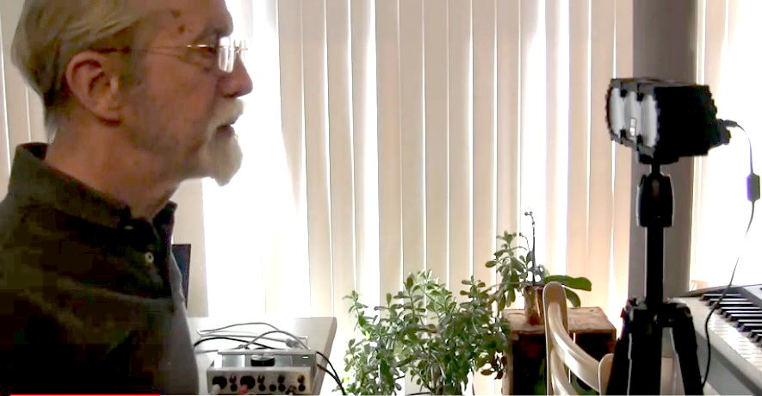
Headphone equalization by listening for equal loudness.
There is an IEC standard that uses tones to determine equal loudness as a function of frequency.
A reference tone at 1000Hz alternates with a tone at a test frequency once per second. The subject adjusts the level of the test tone until it is equally loud as the reference.
The standard states that most subjects can repeat these measurements with an accuracy of +- 1dB.
We have developed apps that use the IEC method to equalize headphones, using a reference at 500Hz and 1/3rd octave noise bands.
Our apps use a compensated 28 band graphic Q=5 equalizer. The equalizer is first used to equalize the loudspeaker. It is then used to find the listener’s personal equal loudness spectrum, and then used to find the headphone equal loudness at the eardrum. The app then equalizes the headphone to match the listener’s personal eardrum spectra fro a frontal source.
The headphone equalization is found by subtracting the loudspeaker equal loudness data from the headphone data. The result is great sound!

Slide 29
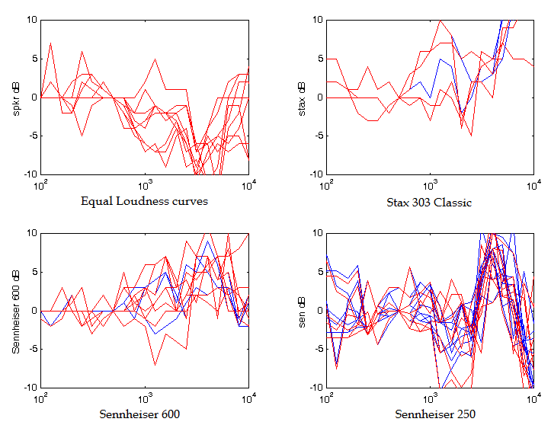
Equal loudness and headphone data from acoustics graduate students at Rensselaer University
The graphs show their individual equal loudness curves from a loudspeaker, and then the headphone equalizations found by a group of graduate students at Rensselaer.
Notice the extreme differences in the resulting headphone equalizations.

Slide 30
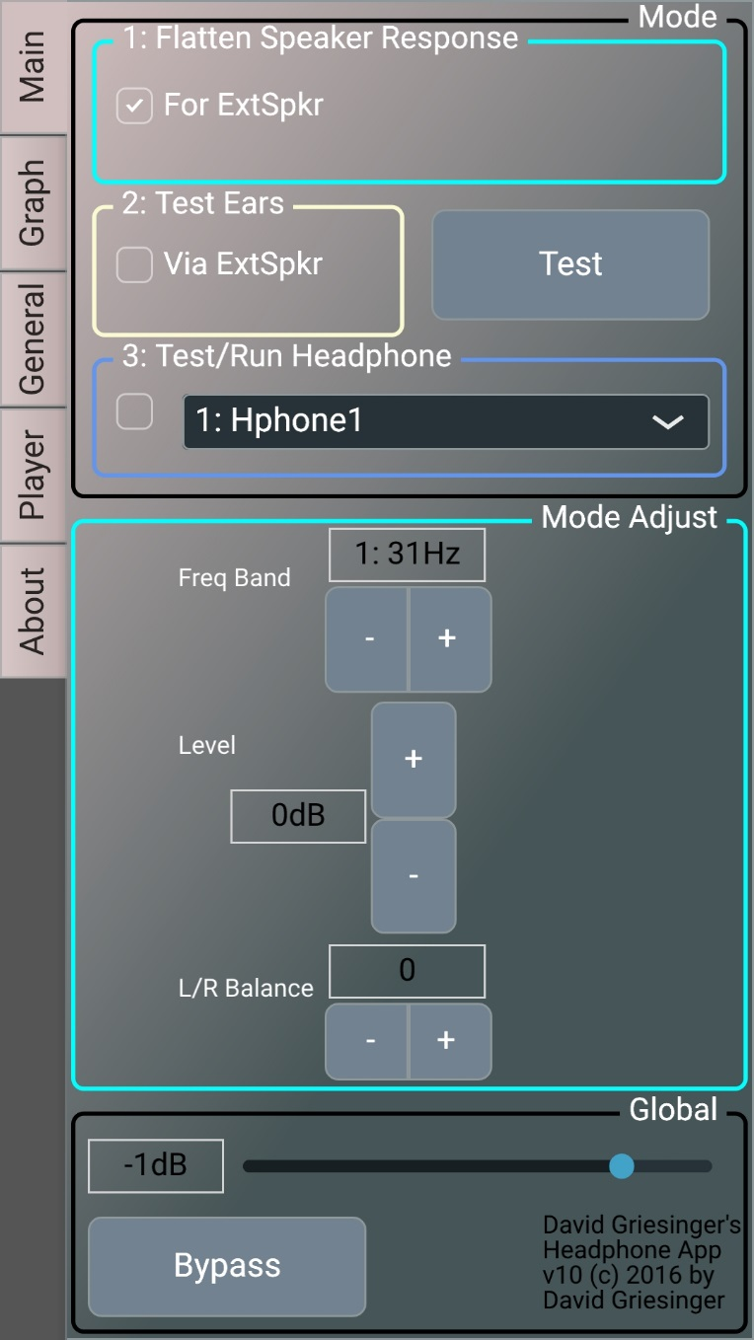
Here is a screen-shot of our app for a cellphone.
You start by checking the “Flatten Speaker Response” box. Plug in your speaker and Click “Test.” The app sends stereo pink noise to your external speaker. Use the equalizer buttons to adjust the frontal response the speaker to flat.
Then check “Test Ears” and click “Test”.
The app sends alternating noise bands to your speaker. Adjust each test band to be equally loud.
Then unplug the speaker and plug in your phones. Check “Test/Run Headphone” and Click “Test.” Adjust for the alternating noise bands to have the same loudness just as you did with the speaker.
When you are satisfied with the data, unclick “Test,” and play music. The app includes a full file player. The app also makes graphs of your eq.
To hear the difference the equalization makes, click “Bypass.”

Slide 31
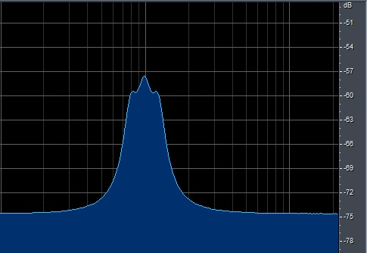
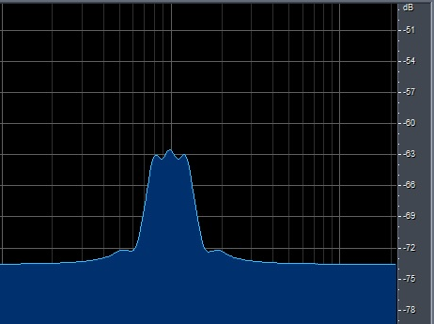
Our app uses a synch function to reduce interactions between bands, and writes graphs for all your data.
A combination of three bands, 800Hz, 1000Hz, and 1250Hz at +10dB without interaction compensation. They raise the level by 15dB.
The same three filters with our app have sharper skirts and the correct level, +10dB.

Slide 32
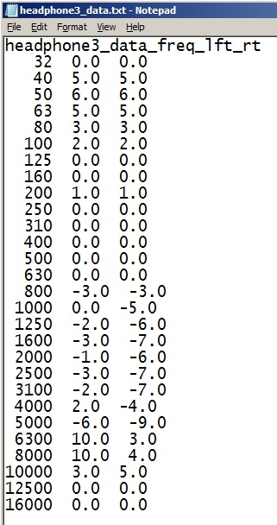
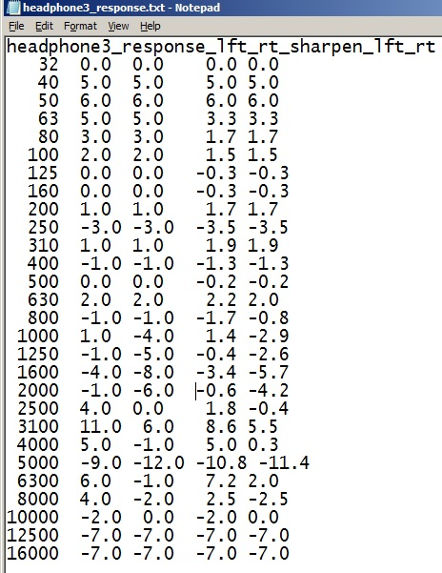
The app has memory banks for five different headphones, and stores all data as editable .txt files.
Here is an example of my equal loudness data for Apple earbuds, found by subtracting the speaker equal loudness from the headphone equal loudness.
Here is my equalization file for Apple earbuds.
The first two columns are the values needed for a compensated equalizer such as the one in our app.
The second two columns have been corrected for a standard 1/3rd octave constant Q equalizer.

Slide 33
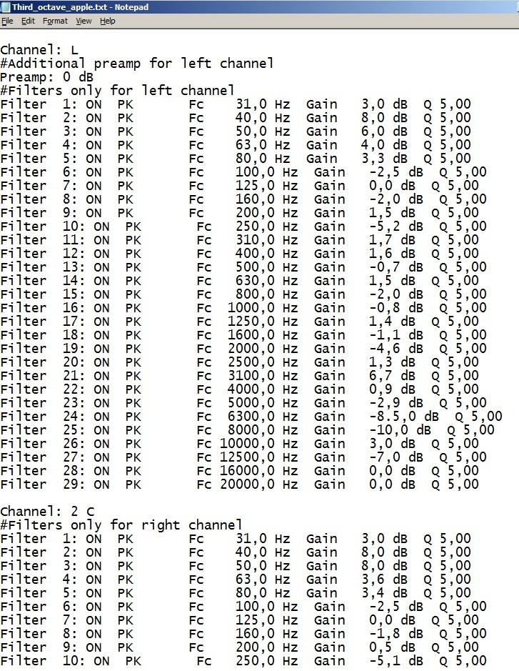
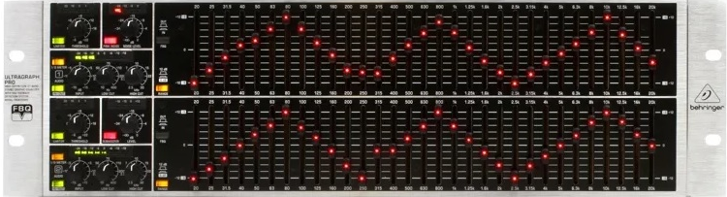
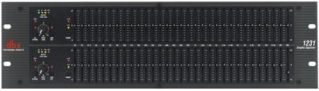
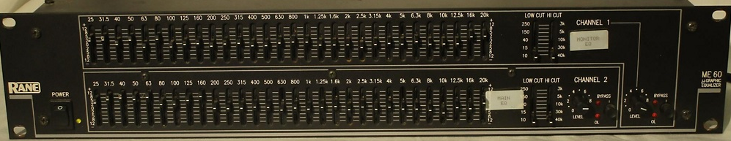
Your headphones can be played with the equalizer in the app, or with an external 1/3rd octave eq.
A Windows application called “EqualizerAPO” inserts a 1/3rd octave constant Q equalizer between the audio output stream and the headphone jack. We supply a template for a 28 band stereo equalizer with a Q of 5. You enter the values in the second two columns of the response file and you are ready to listen. Here is an example of the EqualizerAPO config file for a pair of my Apple earbuds.
A commercial 1/3rd octave EQ also works if you enter the dB values in the second two columns of the headphone response data.
If you are using a digital equalizer that works in the frequency domain, use the data in the first two columns.

Slide 34
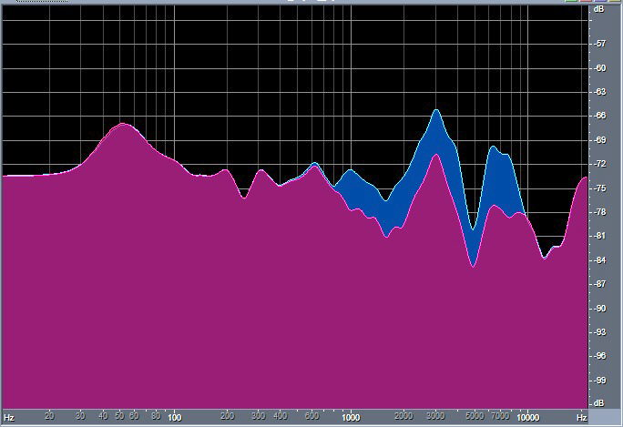
The original Windows app can write an impulse response as a .wav file for any of the data in the equalizer. These can be plotted with Audition.
Here is the spectrum of the response correction for my Apple earbuds.
My hearing is weaker in the left ear than the right by about 5dB above 1000Hz. Adjusting the balance control when finding the headphone equal loudness corrects the imbalance.
The resulting correction curve is higher on the left than on the right above 1000Hz.
When I listen to music the sound is perfectly balanced.

Slide 35
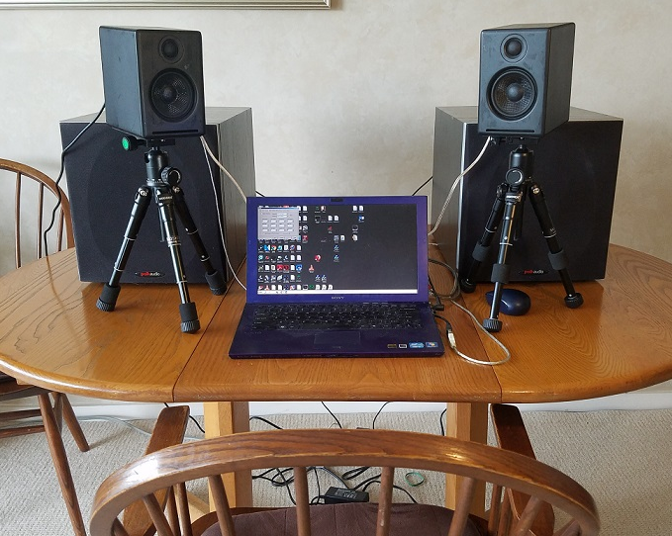
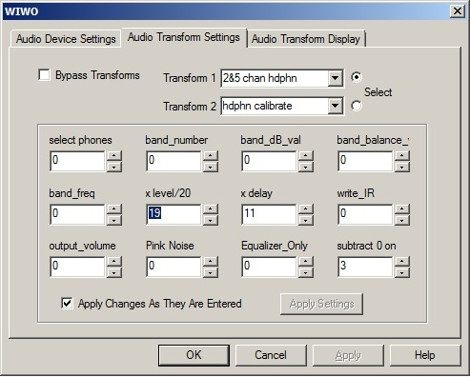
Reproducing binaural recordings with crosstalk cancellation
Here is the control panel for our original Windows headphone and crosstalk app. It also can be used for headphone equalization. There is a YouTube video showing how to use it.
The original Windows application is available from the author by request.

Slide 36
Crosstalk cancellation creates virtual headphones just outside the listener’s ears
Our crosstalk cancellation system uses simple filters in the time domain. The filters can be user-adjusted to fine tune them to an individual, but we find the default settings work well.
We also correct for the +-40 degree HRTF of the listener, which gives better performance for sources above and behind.

Slide 37
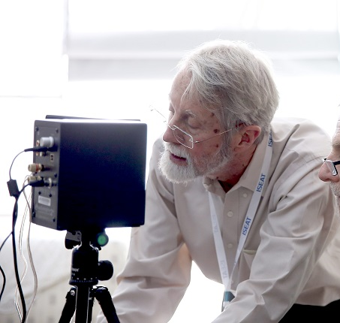
I hope you will some day have the opportunity to hear our individual headphone equalization and our crosstalk system.
The End

